Slide 1
Close Task Management – Increase flexibility to change tasks & parameters after close checklist submission

Slide 2
Change task & parameters after close checklist submission
Challenge and new Service & Architecture
Challenge:
With the old architecture as soon as a task list has been submitted, all tasks were submitted as well
These submitted tasks were in status „Event Wait“ for an extensive time as long as predecessors were not completed or planned start date was not met
Inflexibility for task list owner to change tasks/task parameters despite the tasks was still in “Event Wait”
New middle-layer Architecture and Delayed Submit Service
A new middle-layer architecture has been introduced that allows to submit a task-list but not submitting all tasks
The delayed submit enables to submit a task only when its predecessors are completed and planned start-date is due
A new status “planned” is introduced for tasks that can be changed despite the tasks list is submitted
This allows to change tasks & task parameters for an extended time despite task list has been submitted

Slide 3
Defined Flexibility to change tasks and task list parameters
Enabled Changes & Ramifications
Possible Changes for tasks in already submitted task list:
Add milestones/ change milestones
Add task parameters e.g. responsibilities, timings, escalation routes
Changes for single task or multiple tasks (mass changes)
Ramifications – what is not possible:
Introduce new task in an already submitted task list Delete existing tasks but able to skip
Definition/Name of tasks
Change task execution (global/local) task
Modifying dependency

Slide 4
Workbench as the UI to select tasks for editing
Workbench is the UI to trigger changes
Start from standard workbench, pre-filter workbench or Orchestrator Instance workbench
Only tasks that are in delayed submit have a check-box to allow selection
Check-box allows to “Select All” or Select individual (one or multiple) tasks
Action Button to edit/change selected task (Edit-Button) is initially disabled and enabled when at least on task is selected
Click-boxes
to select one or multiple tasks (including option to select all)

Completed
Planned
Running
Planned
Planned
Edit
Action Button to select tasks for editing (only enabled when at least on task is selected)

Slide 5
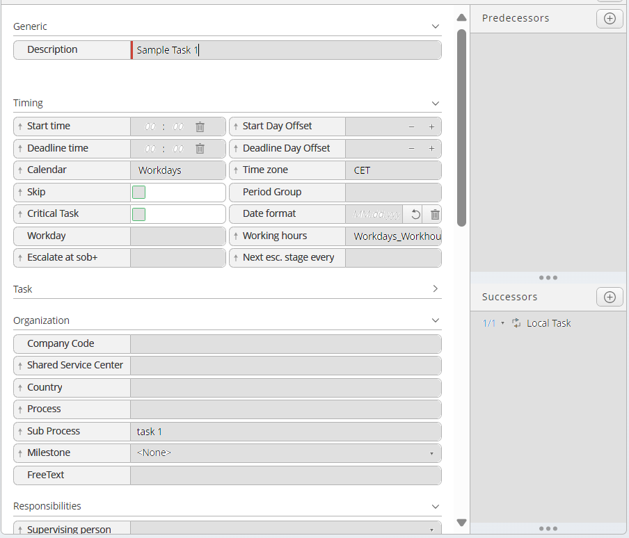
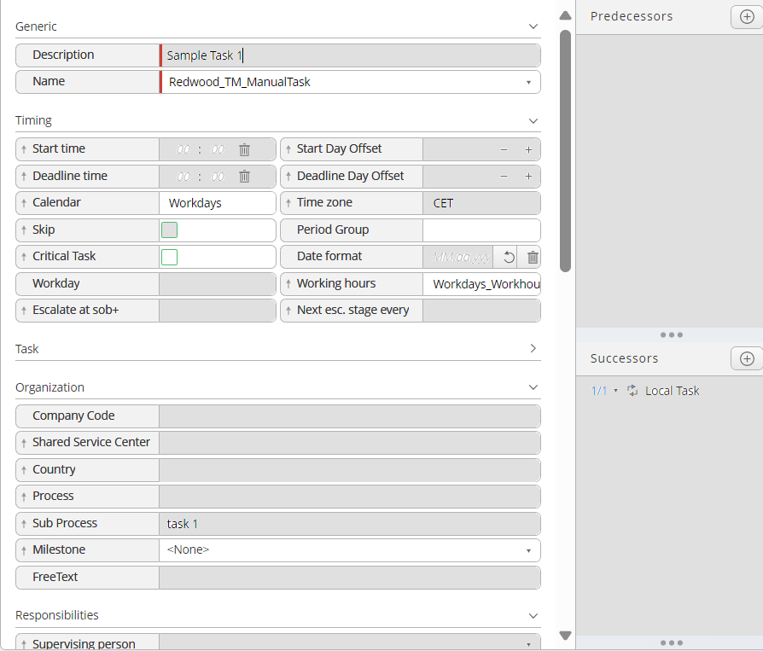
Define Change for single task
If a single task has been selected for change, the screen with current settings will be displayed.
Only Fields that can be changed are shown as greyed out prior to any change
After changes the fields become white and contain an ´”revert button” enabling to change back to initial value
To delete field content, user will move in the specific field and keep it empty before moving to a next field
“Apply” and cancel button at the bottom of the screen (Apply only enabled after change)
APAC
month
☑
New_WH
Change on:
Calendar
Critical Task
Period Group
Working Hours
Milestone
Asset Close
Save
Save

Slide 6
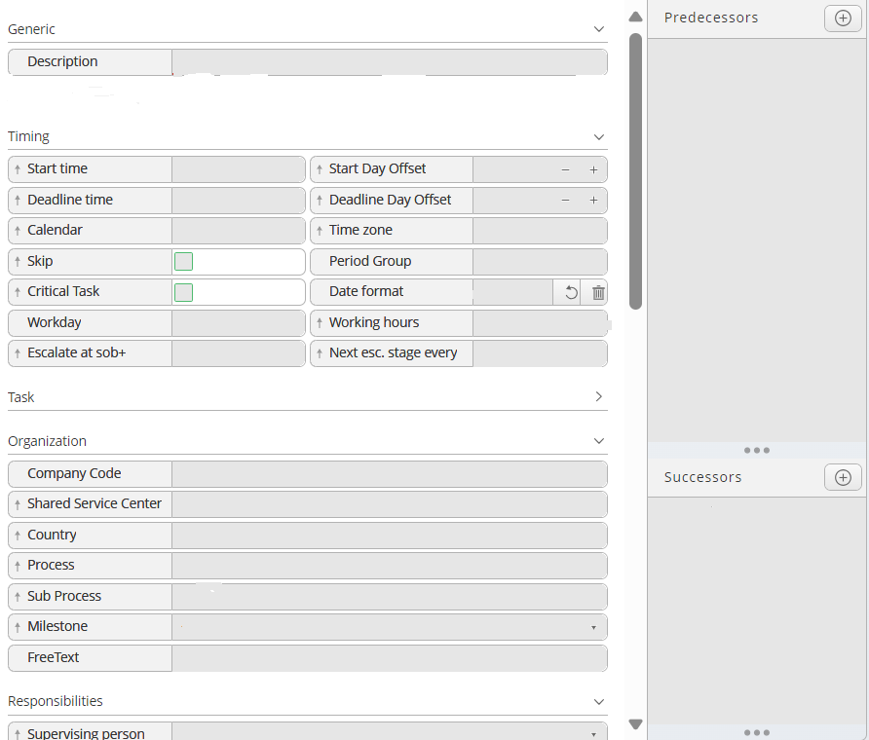
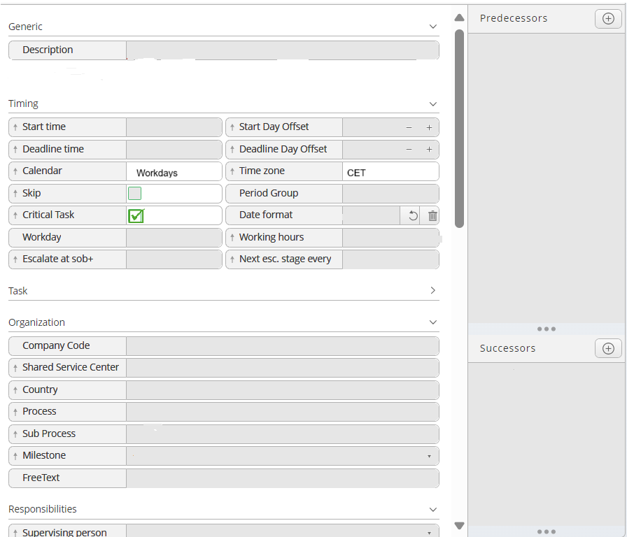
Define Change for multiple tasks
If multiple tasks has been selected for change, the selected tasklist and tasks are displayed on the left.
All fields and only fields relevant for any task that can be changed are shown
Initially all fields are greyed to indicate that they have not be changed
After the field has been changed it is shown in white colour and indicator allowing to revert change is shown
Save and cancel button at the bottom of the screen
Confirmation Message when saving “Are you sure that you want to overwrite current task parameter”
Task List: Quarter-end
Depreciate asset
Run HR Report
Task List: Half-year Close
AP Accrual Posting
Consolidation Upload
Task List: Quarter-end
Depreciate asset
Run HR Report
Task List: Half-year Close
AP Accrual Posting
Consolidation Upload
Change on:
Calendar
Time Zone
Critical Task
Save
Save

Slide 7
Topics for further Investigation and Discussion
Shall the normal workbench always show the “select for edit” or how do we trigger the specific workbench view with the “Select” and “Edit” option Assumption - yes
Will tasks in “delayed submit” be visible in the standard workbench view? Assumption - yes
Should we show all tasks or only tasks in “submit delay” status in the “edit” selection view? Assumption - no but only those can be selected for “edit”
Shall we also be able to maintain parameters at the group level Assumption – no but then we need to ensure that tasks parameter can be maintained independent of the groups and that group parameters do not overwrite task parameters when submitting
Are up-front check boxed the standard UI element we want to use for item selection in workbench? Assumption: yes
Do we need an additional security concept or can the security settings for the underlying task list and tasks being applied? (Security settings in the task list as well as company code restrictions) Assumption: Security settings as in the task list security tab will be applied, In addition org-unit auth will be applied
Shall changes to the parameters of a “delayed submit” task only impact the already submitted task list instance or the task list itself? Assumption: Initially we only apply to the delayed submit tasks – only in further release we shall apply changes to underlying task list as well
Do we need to consider a scenario where multiple instances of same task list are processed? Assumption: no

